Slide 1
Azure Introduction
Michael Chi
Technical Evangelist

Slide 2
Azure

Slide 3

22
座大型資料中心
資料中心
遍佈全球
超過 AWS 以及 Google Cloud 的總和
Azure compute regions
Notes:
https://azure.microsoft.com/en-us/regions/

Slide 4
Azure 使用情形
>90,000
新的 Azure 訂閱用戶（每月）
1 千 4 百萬
SQL 資料庫服務運作中
>50 兆
個儲存體物件
4.25 億
Azure Active Directory 用戶
3 百萬
位開發人員使用 Visual Studio Online
>40%
營收來自新創公司與軟體開發商

Slide 5




















































Security & Management
Platform Services
Hybrid
Operations
Compute
Web and Mobile
Developer Services
Portal
Cloud
Services
Service
Fabric
Web Apps
API
Apps
API
Management
Visual Studio
Azure SDK
Azure AD
Connect Health
Active
Directory
Batch
Remote App
Mobile
Apps
Logic
Apps
Notification
Hubs
Team Project
Application
Insights
AD Privileged
Identity Mngt
Multi-Factor
Authentication
Backup
Integration
Analytics & IoT
Data
Automation
Storage
Queues
Biztalk
Services
Operational
Insights
HDInsight
Machine
Learning
SQL
Database
SQL Data
Warehouse
Key Vault
Hybrid
Connections
Service
Bus
Import/Export
Data
Factory
Event
Hubs
Redis
Cache
Search
Store /
Marketplace
Media & CDN
Site
Recovery
Stream
Analytics
Mobile
Engagement
DocumentDB
Tables
VM Image Gallery
& VM Depot
Media
Services
Content Delivery
Network (CDN)
StorSimple
Infrastructure Services
Virtual Machines
Network Attached Storage
Software Defined Networking
Windows
Linux
Containers
BLOB Storage
Azure Files
Premium Storage
Virtual Network
Load Balancer
DNS
Express
Route
Traffic Manager
VPN Gateway
Application Gateway
Datacenter Infrastructure (24 Regions, 19 Online) – More than AWS and Google combined
Notes:
Include this Azure Platform Slide your first slide and highlight the area you’ll be talking about.
This will be the first slide for all Virtual Sessions.

Slide 6







Microsoft Azure 相關服務
Office Add-in
PC
Tablet
Phone
Browser
Games console
On-premises service
On-premises database
Client layer
(on-premises)
AD
多因素身份驗證
身份驗證服務
BizTalk Services
服務匯流排
Logic 應用程式
流量管理員
虛擬網路
Express Route
CDN
整合服務
API 管理
行動 應用程式
Web 應用程式
API 應用程式
虛擬機器
媒體服務
通知中樞
排程器
自動化
雲端服務
應用程式服務
Blobs
Tables
Queues
SQL 資料庫
機器學習
HD Insight
快取服務
備份與還原
StorSimple
資料服務
儲存體
資料

Slide 7
Azure Services

Slide 8
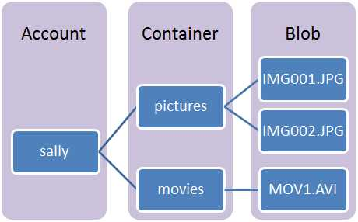
Storage Blob
Storing large amount of unstructured data.
Text, Binary data
Access via HTTP, HTTPS
Token based authentication

Slide 9
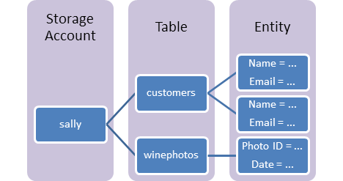
Storage Table
Storing large amount of structured data
Non-SQL data store
Accessing data using Odata protocol and LINQ

Slide 10
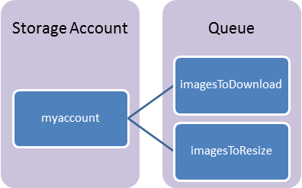
Storage Queue
Storing messages that can be access by authenticated calls via HTTP, HTTPS

Slide 11
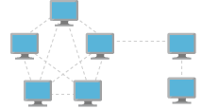
Virtual Network
Isolated environment to run your VMs and applications
Build your network topology
Hybrid environment by Site-to-Site/Point-to-Site VPN

Slide 12

Virtual Machine
Easiest way to adopt cloud power
Deploy your existing solution
Linux & Windows

Slide 13
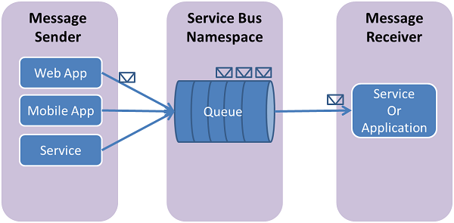
Azure Service Bus Queue
Brokered message communication model
Guarantee FIFO

Slide 14
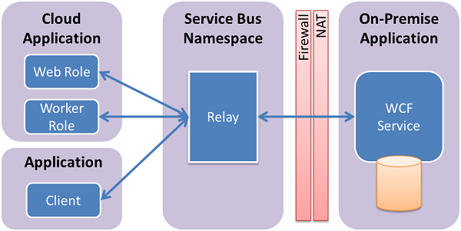
Azure Service Bus Relay
Enable Hybrid communication
Foundation of App Service Hybrid connection

Slide 15
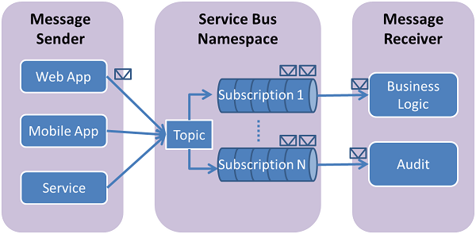
Azure Service Bus Topic & Subscription
Cloud based, Message-oriented-middleware
Publish/Subscription communication

Slide 16
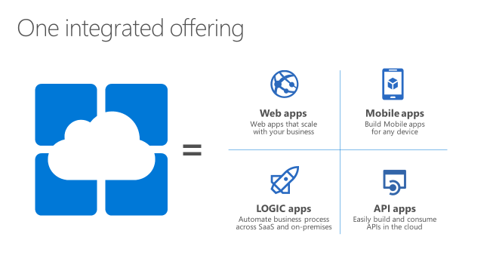
Azure App Service
Build your Web and Mobile application at scale
Simple integration
Dozens of built-in 1st party and 3rd party APIs

Slide 17
Azure IOT

Slide 18
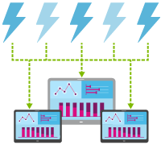
Azure Event Hub
Stream millions of events per second into multiple applications
Connect millions of devices across platforms

Slide 19
Azure IOT Hub
Connect Devices bi-directionally to Azure IoT Services
Receive / Send messages from / to millions of devices concurrently
Control & Monitor Devices
Add / Remove and Enable / Disable devices
Store device information (meta-data)
Per-device Authentication and Authorization

Slide 20
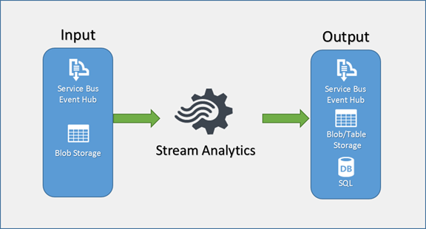
Azure Stream Analytics
Uncover real-time insights
Enable rapid development
Achieve mission-critical reliability and scale

Slide 21
Azure Machine Learning
Get Insights of your data
Create predictive model
HowOld.net
Project Oxford

Slide 22
DEMO
Azure Portal Overview

Slide 23
Reference
New Portal : https://portal.azure.com
Old Portal : https://manage.windowsazure.com

Slide 25
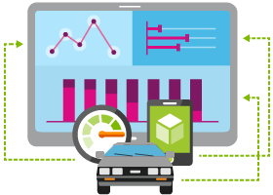

物聯網（Internet of Things）
事件中心 (Event Hubs)
通知中樞
串流分析 (Stream Analytics)
機器學習
HDInsight
Power BI for Office 365
透過 Microsoft Azure IoT 服務，您可以有效地監控既有資產、增加操作效率來引發創新、以及利用進階的資料分析來帶領公司商業模式的轉型，以及增加營收來源
Notes:
Speaking Notes
Azure Mobile Services is a Backend-as-a-Service
Instead of you having to design, build, test, deploy, manage, and upgrade your whole backend, we do it for you
Features of Mobile Services
Storage – SQL DB
Authentication – built in support for social providers w/ ability to custom auth
Backend logic – data validation, logical flows, etc
Push Notifications – across all major mobile platforms
Scheduler – backend job processing

Slide 26

Azure IoT 資料流情境
事件來源
收集
擷取 (broker)
轉換
永久儲存
資料呈現或因應動作
串流分析
Web/應用程式 儀表板
應用程式
Service bus
傳統 IOT (自訂通訊協定)
事件中心
Azure DBs
串流處理
搜尋與查詢
一般裝置
Cloud gateways (web APIs)
Azure storage
具備 IP 的裝置 (Windows/Linux)
儲存體 連接器
HDInsight
資料分析 (Excel)
低功耗裝置 (RTOS)
Field gateways
觸發裝置反應

Slide 27
Section Title

Slide 28
Section Title

Slide 29
Section Title

Slide 30
Title for slide goes here
Bullet point 1 goes here
Bullet point 2 goes here
Bullet point 3 goes here
Bullet point 4 goes here
Potential highlight or call to action goes here

Slide 31
Title for slide goes here
Bullet point 1 goes here
Bullet point 2 goes here
Bullet point 3 goes here
Bullet point 4 goes here
Potential highlight or call to action goes here

Slide 32
Title for slide goes here
Bullet point 1 goes here
Bullet point 2 goes here
Bullet point 3 goes here
Bullet point 4 goes here
Potential highlight or call to action goes here

Slide 33

Title for image slide goes here
Place supporting copy or bullet points here place supporting copy or bullet points here place supporting copy or bullet points here place supporting copy or bullet points here

Slide 34
Title for image slide goes here
Place supporting copy or bullet points here place supporting copy or bullet points here place supporting copy or bullet points here place supporting copy or bullet points here

Slide 35

Title for slide goes here
Subtitle
Outline 1: Description goes here description goes here description goes here
Outline 2: Description goes here description goes here description goes here
Outline 3: Description goes here description goes here description goes here
Another subtitle
Outline 1: Description goes here description goes here description goes here
Outline 2: Description goes here description goes here description goes here
Outline 3: Description goes here description goes here description goes here ☺

Slide 36
Title for slide goes here
Bullet point 1 goes here
Bullet point 2 goes here
Bullet point 3 goes here
Bullet point 4 goes here
Bullet point 1 goes here
Bullet point 2 goes here
Bullet point 3 goes here
Bullet point 4 goes here

Slide 37
Title for slide goes here
Bullet point 1 goes here
Bullet point 2 goes here
Bullet point 3 goes here
Bullet point 4 goes here
Bullet point 1 goes here
Bullet point 2 goes here
Bullet point 3 goes here
Bullet point 4 goes here

Slide 38
Title for slide goes here
Bullet point 1 goes here
Bullet point 2 goes here
Bullet point 3 goes here
Bullet point 4 goes here
Bullet point 1 goes here
Bullet point 2 goes here
Bullet point 3 goes here
Bullet point 4 goes here

Slide 39
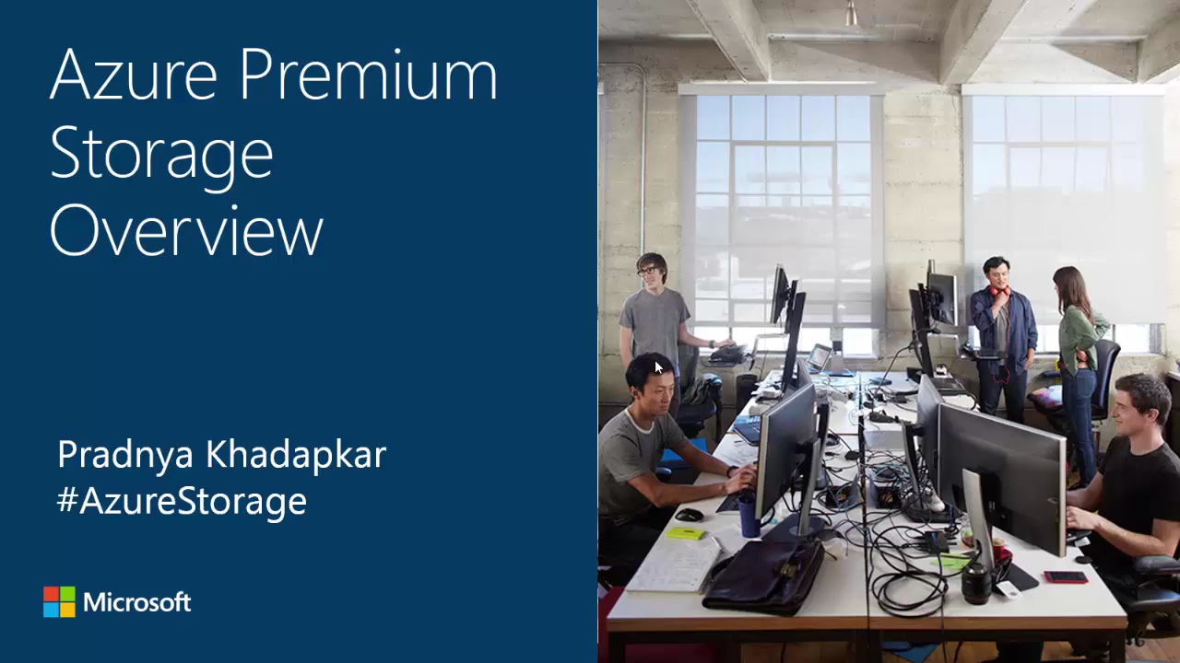
Embedded video placeholder
Place secondary text here if needed

Slide 40
Linked video placeholder
Place secondary text here if needed

Slide 41

Screenshot placeholder
Place secondary text here if needed

Slide 42
Screenshot placeholder
Place secondary text here if needed

Slide 43
Screenshot placeholder
Place secondary text here if needed

Slide 44
Slide with code title
This slide layout uses Consolas, a monotype font which is ideal for showing software code.

Slide 45
Slide with code title
This slide layout uses Consolas, a monotype font which is ideal for showing software code.

Slide 46
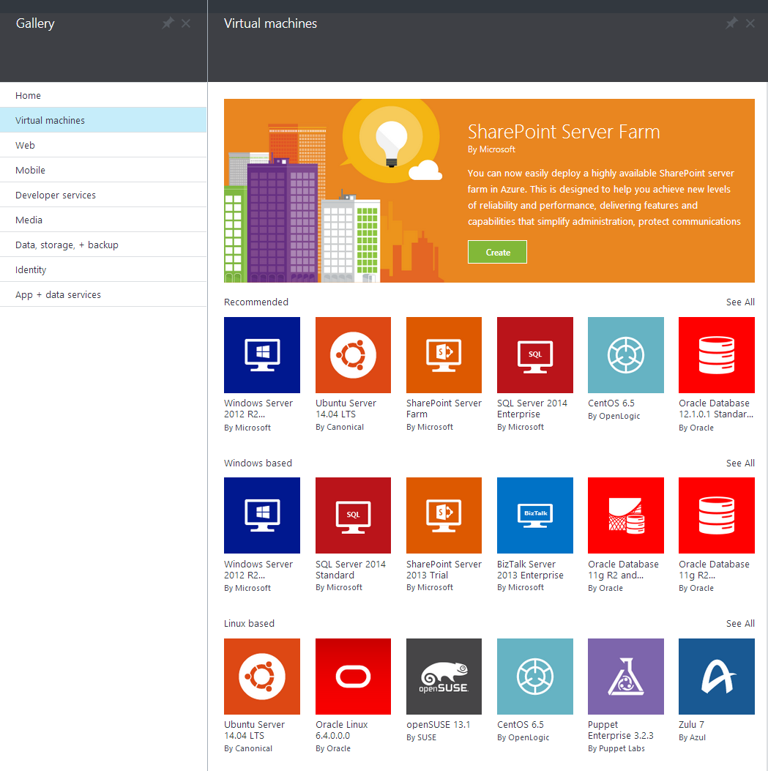
Alternate screenshot placeholder
Place supporting copy or bullet points here

Slide 47
Alternate screenshot placeholder
Place supporting copy or bullet points here

Slide 49
Appendix

Slide 50










Icons to use

Slide 51
Icon copy 1
Icon copy 2
Icon copy 3

Slide 52



Server enabled
Data optimized
Cloud accessibility
Notes:
Example usage – optional.

